Slide 1
Python Stock Tracker
Arman pabla

Slide 2
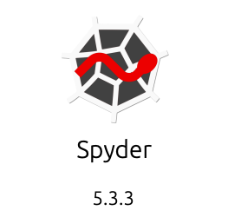
Introduction
This project provides an application in Python using object-oriented techniques to develop a stock tracking application, including a console and GUI (Graphical User Interface). The system uses python libraries to create charts, retrieve historical stock data from websites, and process profit/loss data reports.

Slide 3
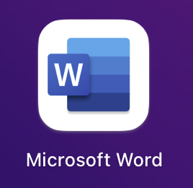
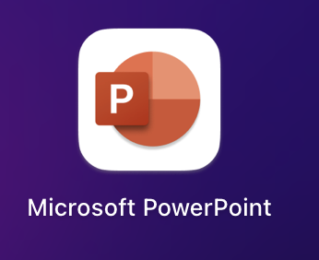
Programs Used:
Anaconda-Navigator
Spyder (Python)
Microsoft Word
Microsoft PowerPoint

Slide 4
Object Oriented Programming (OOP)
The initial part of the project: Create Classes with our Stock and History Data. These classes are the foundation of the program.
Objective:
Create Class Diagrams
Create Classes
Run Unit Test

Slide 5
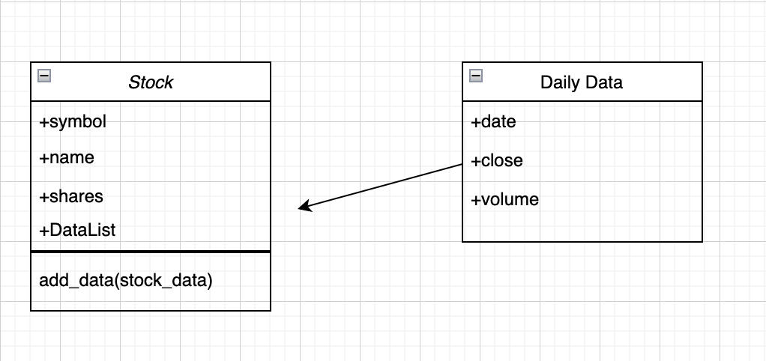
OOP Completed Objectives
Class Diagrams
Classes Created

Slide 6
OOP Unit Test
I learned how to create a diagram of the classes necessary using a web tool (diagrameditor.com), then rolled into Spyder to create a class after understanding the logic. A unit test was in place to attempt creating new stock, adding price history to the stock, and test changing the stock symbol. The test will produce a report showing which tests passed or failed, then provide a summary list of errors.
Successful Unit Test

Slide 7
Menu-Driven User Interface
A console-based interface working with stocks and the stock price history
Objective:
Create a Menu-Driven User Interface to Add/List/Delete Stocks, and to Track Price and Volume History
Create Functions to handle menu items

Slide 8
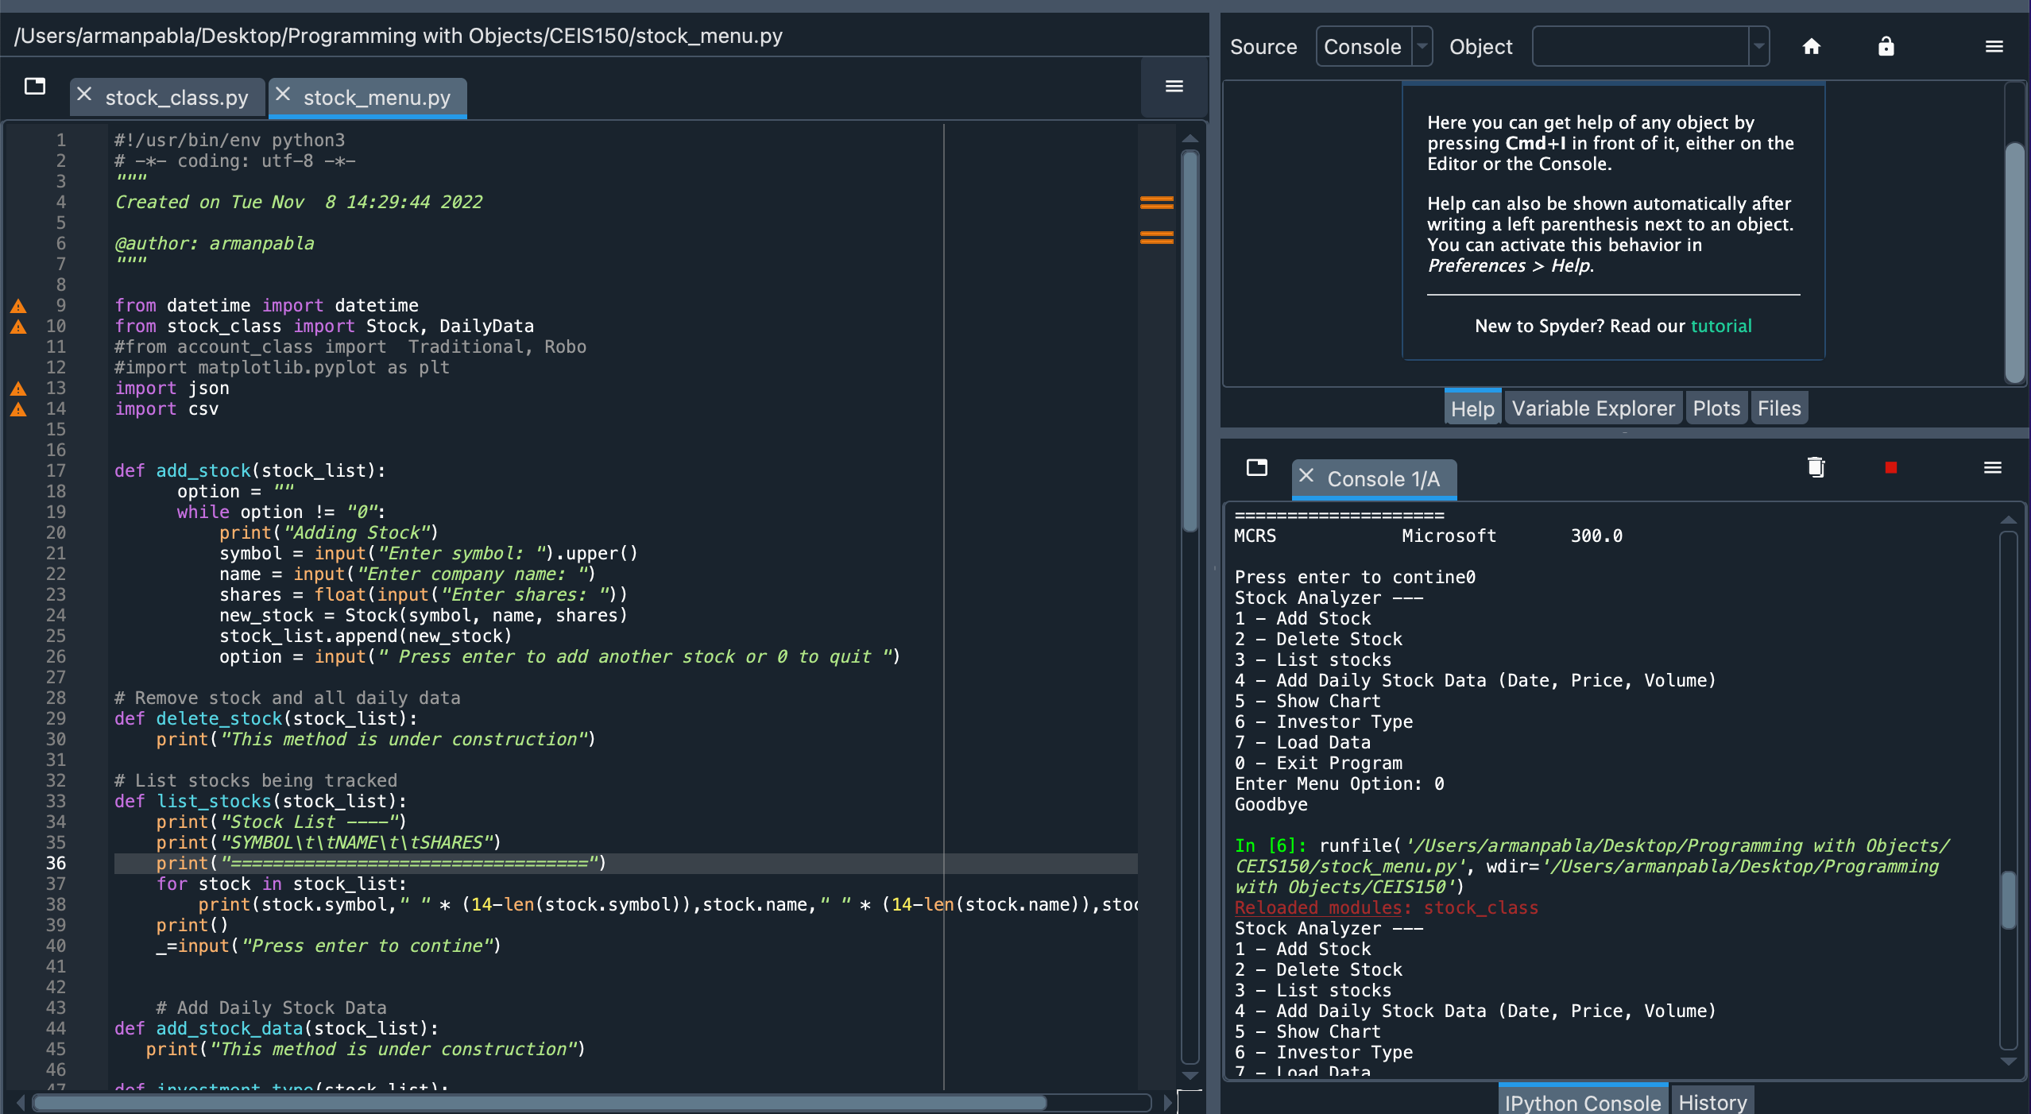
Menu: Adding a Stock
The green arrow shows the code to add a stock, line 17.

Slide 9
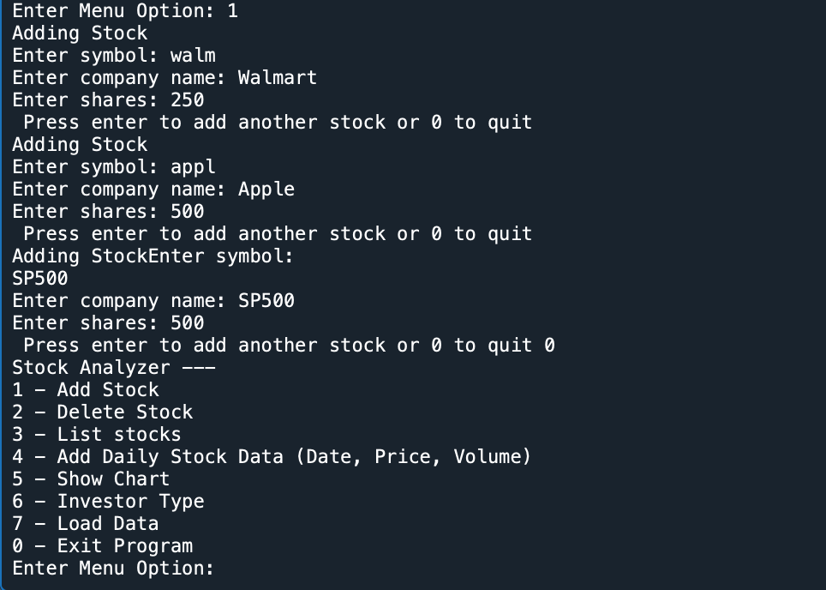
Menu: Listing 3 Stocks
The green arrows show the stock entries: Walmart, Apple and SP500
The blue arrow shows the Menu, listing options from 1-7, 0 to exit the program.

Slide 10
Menu: Daily Data
The following shows a successful Daily Stock entry
I learned how to create and implement a menu in a program that allows the user to enter daily entries and build stock information.

Slide 11
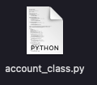
Inheritance
Inheritance was implemented into the stock program allowing to create of two types of retirement accounts. When investing you can choose a traditional retirement account or an automatics account. Traditional allows you to choose the specific stocks, compared to the ”Robo Account” the account will invest in a fund for a certain number of years.
Objective:
Implement inheritance in the stock program
Create three classes
Run a Unit Test

Slide 12
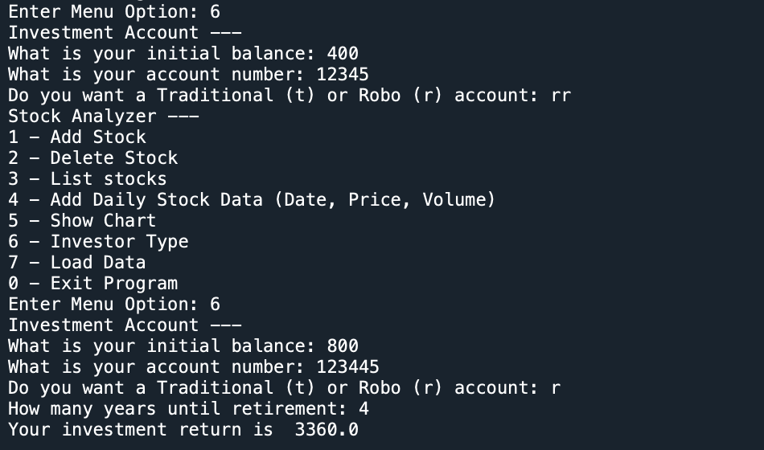
Implement Inheritance

Slide 13
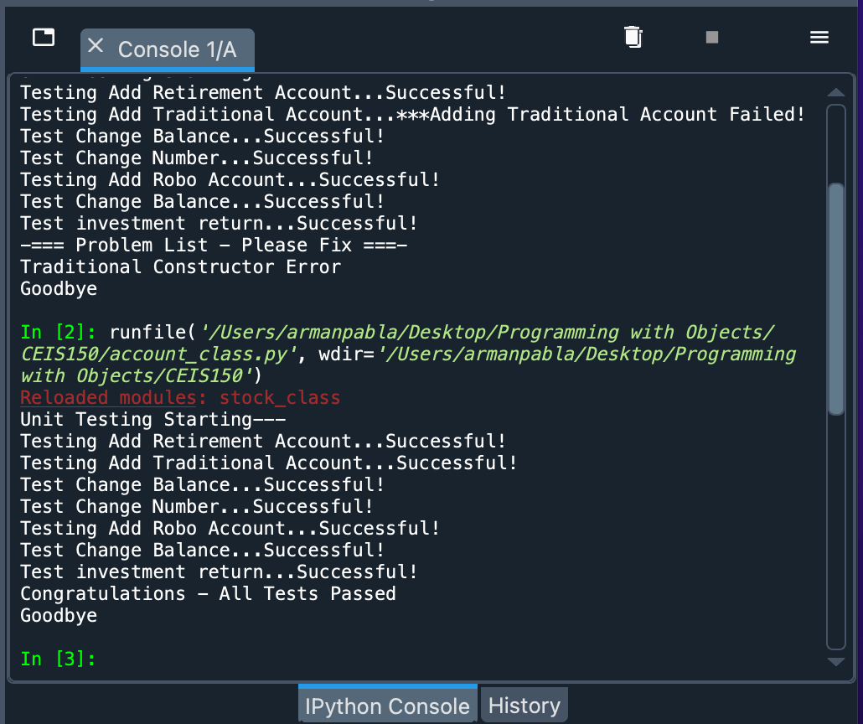
Inheritance Successful Unit Test
I learned how to build a retirement account from a class using inheritance to incorporate two different types of investing accounts.

Slide 14
Displaying Stock Data
After downloading a library matplotlib, it was used to create a chart showing stock prices over time.
Objective:
Use the pyplot class in matplotlib library to create a simple stock chart

Slide 15
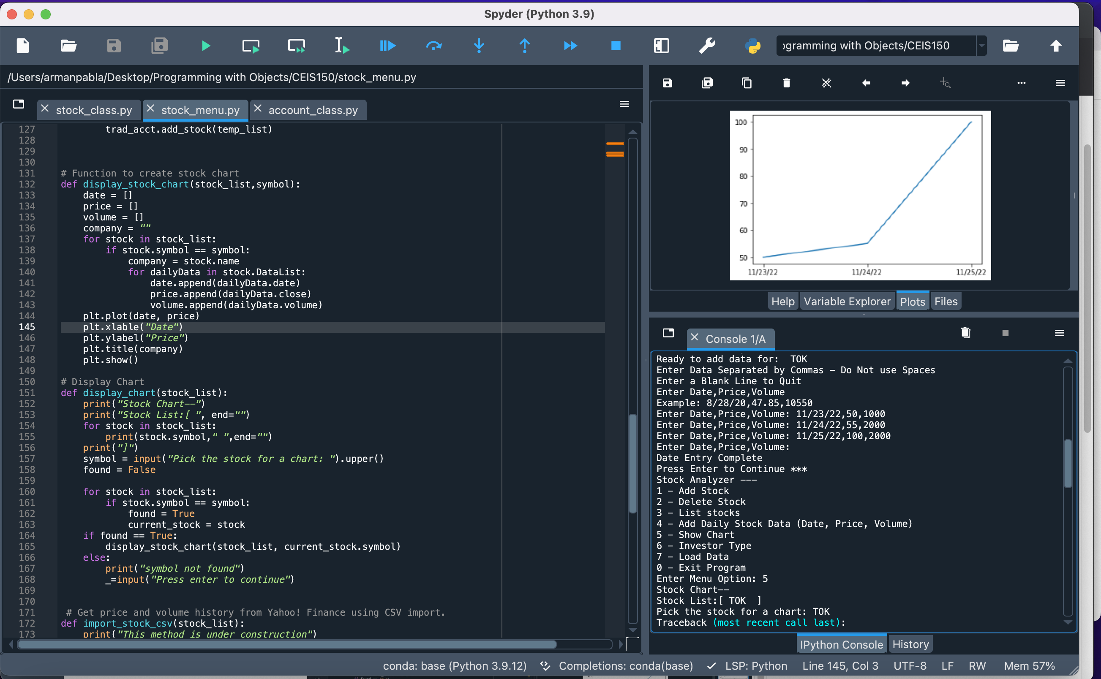
Stock Chart
I learned how to incorporate libraries in order to make my program dynamic.

Slide 16
Files
Saving data and reading data from files. Download and load data from a CSV file.
Objective:
Use the CSV library to import data from Yahoo! Finance
Read data from a file

Slide 17
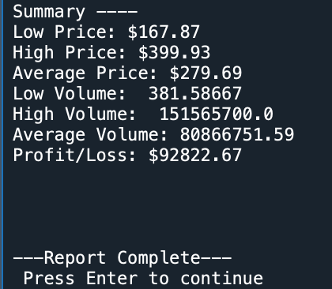
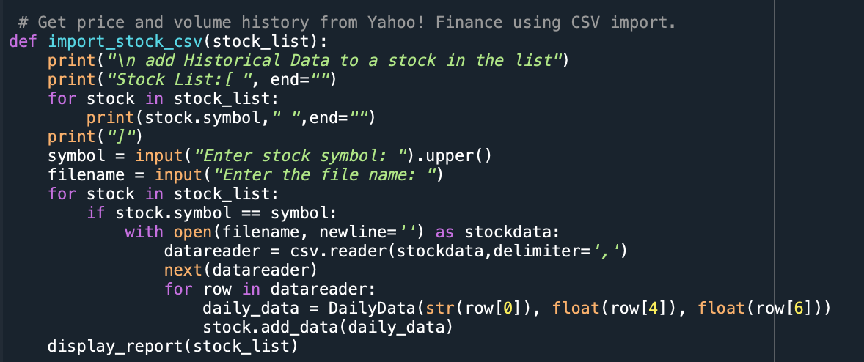
Importing Data from CSV
Display Report
I learned how to save current stock market data and implement it into my program.

Slide 18
Functional Programming and Iterators
Implement a Graphical User Interface for the stock tracking program taking the text-based menu to a modern level.
Objective:
Use tkinter to implement a graphical user interface

Slide 19
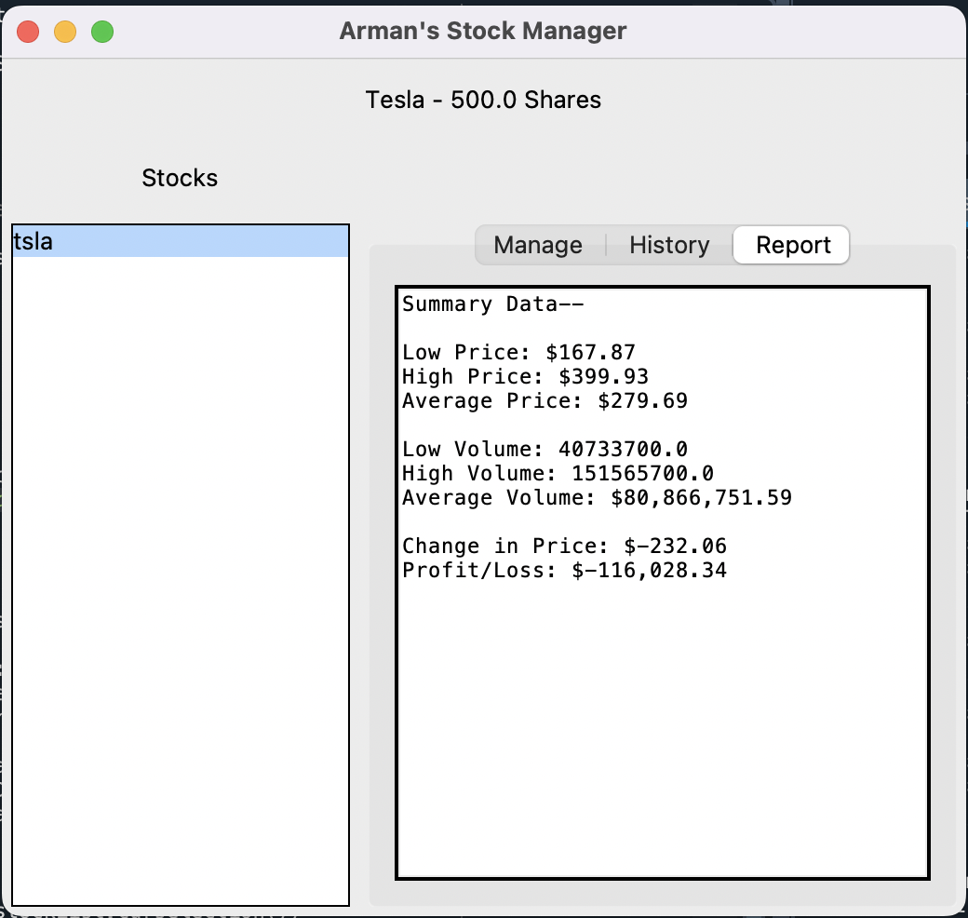
GUI Objective
I learned how to take the program to a whole new level, the user will be able to see a more familiar face of the program.

Slide 20
Career Skills Developed
Object-oriented programming
Building a program using classes
Develop a program using inheritance
Using Python libraries for data storage, analysis, and data visualization.
Concepts of functional programming
Using iterators and generators
Creating Graphical User Interfaces
Saving data and web scraping

Slide 21
Challenges
I am not perfect yet; I ran into simple mistakes that were easily found however it was a good head-scratcher. Simple indentation and syntax errors can be found however, the organization was a challenge up to the third module. It required a lot of attention but was a key factor in the success of the later modules.

Slide 22
Conclusion
This program gave me the confidence that I can step into the programming world knowing I have a great foundation to build off. From the initial class to the graphical user interface each step was essential. I am very proud of this program. Thank you!
Arman Pabla

